Slide 1
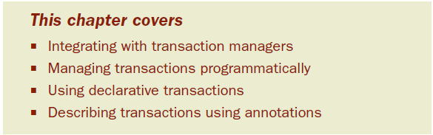
Chapter 6: Managing transactions
Analogy: playing see-saw
In software, all-or-nothing operations are called transactions.
Notes:
-In practice, we know that data access has many pitfalls. We have to initialize our data access framework, open connections, handle various exceptions, and close connections. If we get any of this wrong, we could potentially corrupt or delete valuable company data.

Slide 2
Transactions allow you to group several operations into a single unit of work that either fully happens or fully doesn’t happen.
Money transfer example
When writing to a database, we must ensure that the integrity of the data is maintained by performing the updates within a transaction.
Spring has rich support for transaction management, both programmatic and declarative.
Notes:
Imagine that you were to transfer Php10,000 from your savings account to your checking account. The transfer involves two operations: Php10,000 is deducted from the savings account and Php10,000 is added to the checking account.

Slide 3
6.1 Understanding transactions
To illustrate transactions, consider the purchase of a movie ticket.
The number of available seats will be examined to verify that enough seats are available for your purchase.
The number of available seats is decremented by one for each ticket purchased.
You provide payment for the ticket.
The ticket is issued to you.
Notes:
-For instance, what if you paid with a credit card that had reached its limit? Certainly, you wouldn’t receive a ticket and the theater wouldn’t receive payment. If the number of seats isn’t reset to its value before the purchase, the movie may artificially run out of seats (and thus lose sales).
-To ensure that neither you nor the theater loses out, these actions should be wrapped in a transaction.

Slide 4
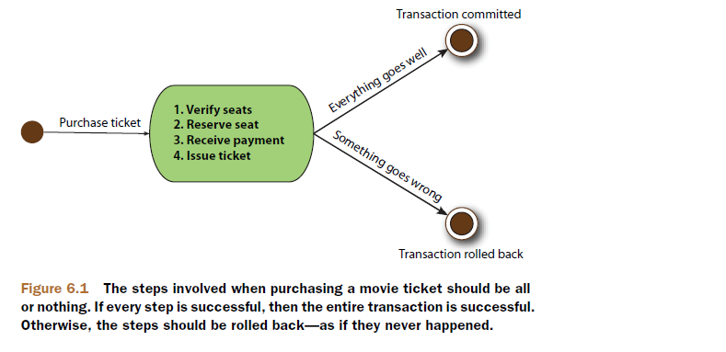
As a transaction, they’re all treated as a single action, guar- anteeing that either they’ll all fully succeed or all be rolled back as if these steps never happened.

Slide 5
Transactions play an important role in software, ensuring that data and resources are never left in an inconsistent state.
Without them, there’s potential for data to be corrupted or inconsistent with the business rules of the application.

Slide 6
6.1.1 Explaining transactions in only four words
In the grand tradition of software development, an acronym has been created to describe transactions: ACID.
Atomic—Transactions are made up of one or more activities bundled together as a single unit of work.
Consistent—Once a transaction ends (whether successful or not), the system is left in a state consistent with the business that it models.

Slide 7
Isolated—Transactions should allow multiple users to work with the same data, without each user’s work getting tangled up with the others.
Durable—Once the transaction has completed, the results of the transaction should be made permanent so that they’ll survive any sort of system crash.
In the movie ticket example, a transaction could ensure atomicity by undoing the result of all the steps if any step fails.
Atomicity supports consistency by ensuring that the system’s data is never left in an inconsistent, partially done state.

Slide 8
Isolation also supports consistency by preventing another concurrent transaction from stealing seats out from under you while you’re still in the process of purchasing them.
Finally, the effects are durable because they’ll have been committed to some persistent storage
Notes:
-Now that you know the makings of a transaction, let’s see the transaction capabili- ties available to a Spring application.

Slide 9
6.1.2 Understanding Spring’s transaction management support
Spring, like EJB, provides support for both programmatic and declarative transaction management.
Spring’s support for programmatic transaction management differs greatly from that of EJB.
Unlike EJB, which is coupled with a Java Transaction API (JTA) implementation, Spring employs a callback mechanism that abstracts away the actual transaction implementation from the transactional code- doesn’t even require a JTA implementation

Slide 10
If your application uses only a single persistent resource, Spring can use the transactional support offered by the persistence mechanism. This includes JDBC, Hibernate, and the Java Persistence API (JPA). But if your application has transaction requirements that span multiple resources, Spring can support distributed (XA) transactions using a third- party JTA implementation.
Where programmatic transaction management affords you flexibility in precisely defining transaction boundaries in your code, declarative transactions (which are based on Spring AOP) help you decouple an operation from its transaction rules.

Slide 11
Spring’s declarative transactions go beyond Container-managed Transactions(CMTs)-EJBs by allowing you to declare additional attributes such as isolation level and timeouts.
Choosing between programmatic and declarative transaction management is largely a decision of fine-grained control versus convenience.
Typically, you won’t require the fine-grained control offered by programmatic transactions and will choose to declare your transactions in the context definition file.

Slide 12
6.2 Choosing a transaction manager
Spring doesn’t directly manage transactions.
Instead, it comes with a selection of transaction managers that delegate responsibility for transaction management to a platform-specific transaction implementation provided by either JTA or the persistence mechanism.

Slide 13
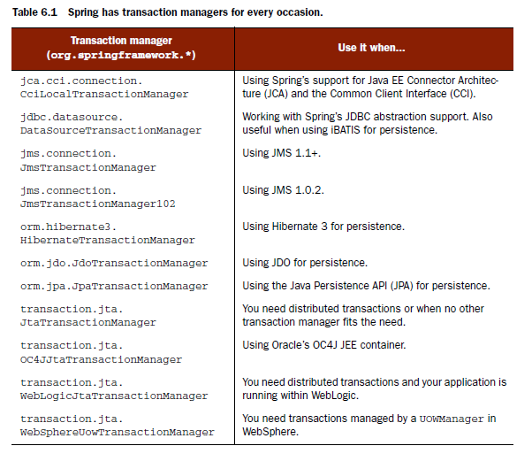

Slide 14
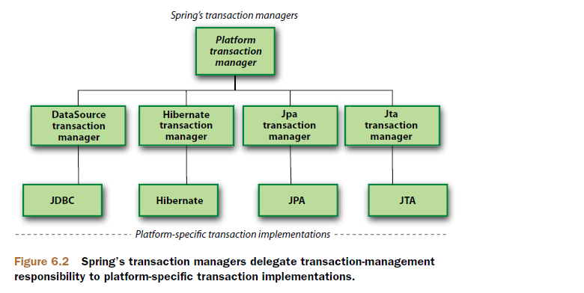
Each of these transaction managers acts as a facade to a platform-specific transaction implementation.
Notes:
-To use a transaction manager, you’ll need to declare it in your application context. In this section, you’ll learn how to configure a few of Spring’s most commonly used transaction managers, starting with DataSourceTransactionManager, which provides transaction support for plain JDBC and iBATIS.

Slide 15
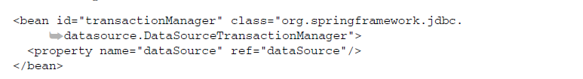
6.2.1 JDBC transactions
If you’re using straight JDBC for your application’s persistence, DataSourceTransactionManager will handle transactional boundaries for you.
Behind the scenes, DataSourceTransactionManager manages transactions by making calls on the java.sql.Connection object retrieved from the DataSource.

Slide 16

6.2.2 Hibernate transactions
If your application’s persistence is handled by Hibernate then you’ll want to use HibernateTransactionManager
The sessionFactory property should be wired with a Hibernate SessionFactory, here cleverly named sessionFactory.

Slide 17
HibernateTransactionManager delegates responsibility for transaction management to an org.hibernate.Transaction object that it retrieves from the Hibernate session.
When a transaction successfully completes, HibernateTransactionManager will call the commit() method on the Transaction object. Similarly, when a transaction fails, the rollback() method will be called on the Transaction object.

Slide 18

6.2.3 Java Persistence API transactions
Hibernate has been Java’s de facto persistence standard for a few years, but now the Java Persistence API (JPA) has entered the scene as the true standard for Java persistence.

Slide 19
JpaTransactionManager only needs to be wired with a JPA entity manager factory (any implementation of javax.persistence.EntityManagerFactory).
JpaTransactionManager will collaborate with the JPA EntityManager produced by the factory to conduct transactions.

Slide 20
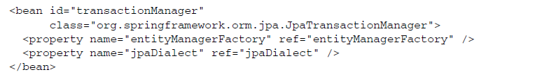
In addition to applying transactions to JPA operations, JpaTransactionManager also supports transactions on simple JDBC operations on the same DataSource used by EntityManagerFactory.

Slide 21
It’s important to note that the JpaDialect implementation must support mixed JPA/ JDBC access for this to work.
All of Spring’s vendor-specific implementations of JpaDialect (EclipseLinkJpaDialect, HibernateJpaDialect, OpenJpaDialect, and Top- LinkJpaDialect) provide support for mixing JPA with JDBC.

Slide 22
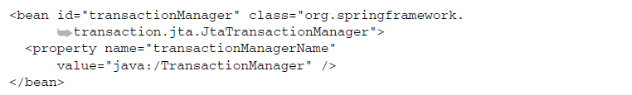
6.2.4 Java transaction API transactions
If none of the aforementioned transaction managers meet your needs or if your trans- actions span multiple transaction sources (for example, two or more different data- bases), you’ll need to use JtaTransactionManager:

Slide 23
JtaTransactionManager delegates transaction management responsibility to a JTA implementation.
JtaTransactionManager works with javax.transaction.UserTransaction and javax.transaction.TransactionManager objects, delegating responsibility for trans-action management to those objects.
A successful transaction will be committed with a call to the UserTransaction.commit() method. Likewise, if the transaction fails, the UserTransaction’s rollback() method will be called.
Notes:
-By now, it should be clear which of Spring’s transaction managers is a best fit for the Spitter application—insomuch as we’ve chosen a persistence mechanism. Now it’s time to put that transaction manager to work. We’ll start by using it to program trans- actions manually.

Slide 24
6.3 Programming transactions in Spring
There are two kinds of people: those who are control freaks and those who aren’t.
If you’re a developer and a control freak, you’re probably the kind of person who prefers the command line and would rather write your own getter and setter methods than to delegate that work to an IDE.
Control freaks also like to know exactly what’s going on in their code. They want full control over where a transaction starts, where it commits, and where it ends. Declarative transactions aren’t precise enough for them.
Notes:
Control freaks like complete control over everything that happens and don’t take anything for granted.

Slide 25
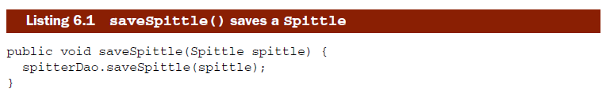
As you’ll see later in this chapter, you’re limited to declaring transaction boundaries at the method level. If you need more fine-grained control over transactional boundaries, programmatic transactions are the only way to go.

Slide 26
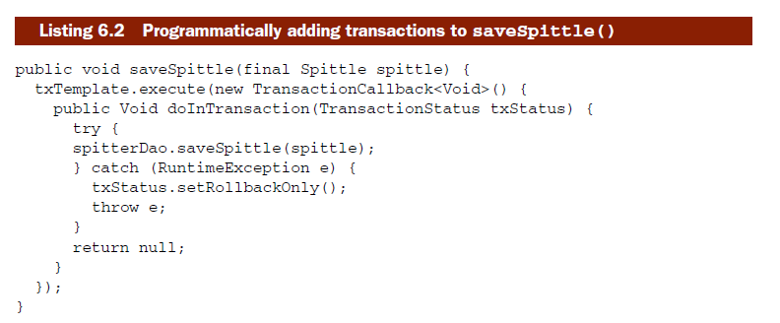
To use the TransactionTemplate, you start by implementing the TransactionCallback interface.

Slide 27
Calling the execute() method on the TransactionTemplate instance will execute the code contained within the TransactionCallback instance.
If your code encounters a problem, calling setRollbackOnly() on the TransactionStatus object will roll back the transaction. Otherwise, if the doInTransaction() method returns successfully, the transaction will be committed.

Slide 28
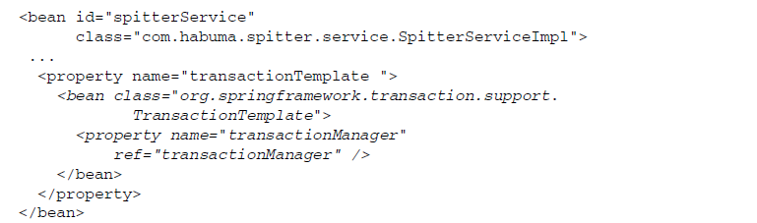
Note that the TransactionTemplate is injected with a transactionManager.
Under the hood, TransactionTemplate uses an implementation of PlatformTransactionManager to handle the platform-specific details of transaction management.

Slide 29
Exercise 6-1
Open spitter-service-programmatic-tx-exercise
Open SpitterServiceImpl and do the necessary wirings for it to have a txTemplate and spitterDao
After properly configuring run SpitterServiceImplTest- should initially pass, take note that saveSpittle is not yet transactional
Make saveSpittle transactional
Perform tests

Slide 30
6.4 Declaring transactions
Not long ago, declarative transaction management was only available in EJB containers. But now Spring offers support for declarative transactions to POJOs.
Spring’s support for declarative transaction management is implemented through Spring’s AOP framework.
This is a natural fit because transactions are a system-level service above an application’s primary functionality.
Notes:
-You can think of a Spring transaction as an aspect that “wraps” a method with transactional boundaries.
-Spring provides three ways to declare transactional boundaries. Historically, Spring has always supported declarative transactions by proxying beans using Spring AOP and TransactionProxyFactoryBean. But since Spring 2.0, the preferred ways to declare transactions are to use Spring’s tx configuration namespace and to use the @Transactional annotation.

Slide 31
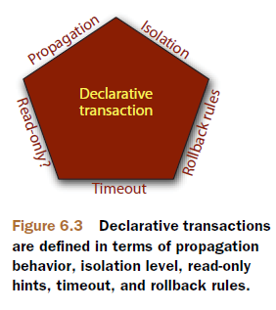
6.4.1 Defining transaction attributes
In Spring, declarative transactions are defined with transaction attributes.
A transaction attribute is a description of how transaction policies should be applied to a method.

Slide 32
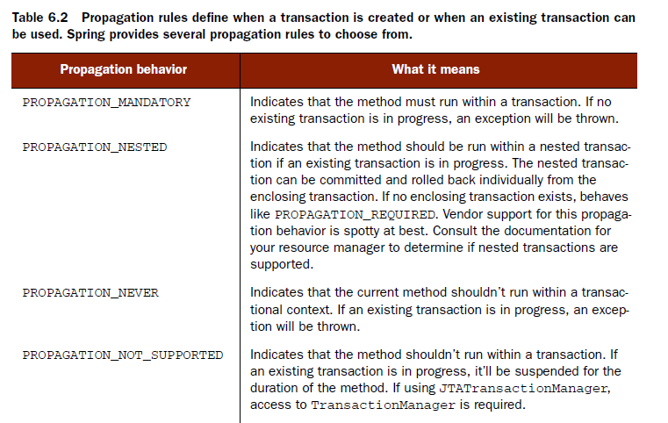
PROPAGATION BEHAVIOR
Propagation behavior defines the boundaries of the transaction with respect to the client and to the method being called.
Notes:
-The propagation behaviors described in table6.2 are defined as constants in the org.springframework.transaction .TransactionDefinition interface.

Slide 33
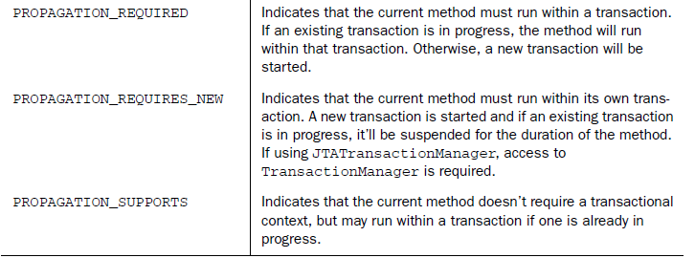

Slide 34
ISOLATION LEVELS
An isolation level defines how much a transaction may be impacted by the activities of other concurrent transactions.
Concurrency, while necessary, can lead to the following problems:
Dirty reads occur when one transaction reads data that has been written but not yet committed by another transaction.
Nonrepeatable reads happen when a transaction performs the same query two or more times and each time the data is different.
Phantom reads are similar to nonrepeatable reads. These occur when a transaction (T1) reads several rows, and then a concurrent transaction (T2) inserts rows. Upon subsequent queries, the first transaction (T1) finds additional rows that weren’t there before.

Slide 35
Perfect isolation can affect performance because it often involves locking rows (and sometimes complete tables) in the data store.
Realizing that perfect isolation can impact performance and because not all applications will require perfect isolation, sometimes it’s desirable to be flexible with regard to transaction isolation.

Slide 36
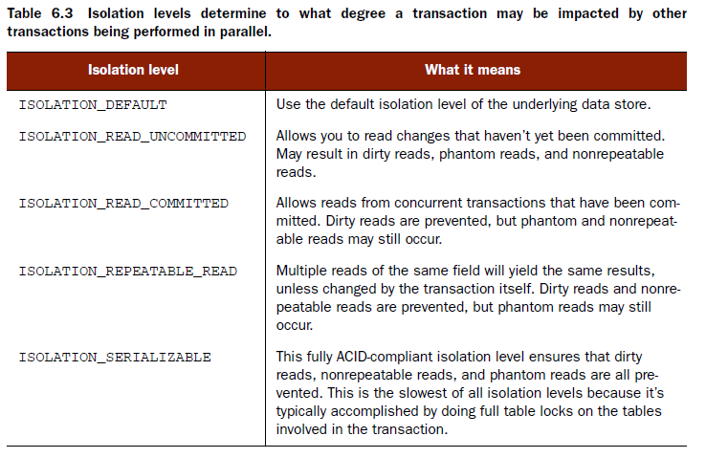

Slide 37
ISOLATION LEVEL CONSTANTS- org.springframework.transaction.TransactionDefinition interface.
ISOLATION_READ_UNCOMMITTED is the most efficient isolation level, but isolates the transaction the least, leaving the transaction open to dirty, nonrepeatable, and phantom reads. At the other extreme, ISOLATION_SERIALIZABLE prevents all forms of isolation problems but is the least efficient.
Notes:
-Be aware that not all data sources support all the isolation levels listed in table 6.3. Consult the documentation for your resource manager to determine what isolation levels are available.

Slide 38
READ-ONLY
If a transaction performs only read operations against the underlying data store, the data store may be able to apply certain optimizations that take advantage of the read-only nature of the transaction.
By declaring a transaction as read-only, you give the underlying data store the opportunity to apply those optimizations as it sees fit.
Because read-only optimizations are applied by the underlying data store when a transaction begins, it only makes sense to declare a transaction as read-only on methods with propagation behaviors that may start a new transaction (PROPAGATION_ REQUIRED, PROPAGATION_REQUIRES_NEW, and PROPAGATION_NESTED).
Notes:
-Furthermore, if you’re using Hibernate as your persistence mechanism, declaring a transaction as read-only will result in Hibernate’s flush mode being set to FLUSH_NEVER. This tells Hibernate to avoid unnecessary synchronization of objects with the database, thus delaying all updates until the end of the transaction.

Slide 39
TRANSACTION TIMEOUT
For an application to perform well, its transactions can’t carry on for a long time. Therefore, the next trait of a declared transaction is its timeout.
Because the timeout clock begins ticking when a transaction starts, it only makes sense to declare a transaction timeout on methods with propagation behaviors that may start a new transaction (PROPAGATION_REQUIRED, PROPAGATION_REQUIRES_NEW, and PROPAGATION_NESTED).
Notes:
-Suppose that your transaction becomes unexpectedly long-running. Because transactions may involve locks on the underlying data store, long-running transactions can tie up database resources unnecessarily. Instead of waiting it out, you can declare a transaction to automatically roll back after a certain number of seconds.

Slide 40
ROLLBACK RULES
The final facet of the transaction pentagon is a set of rules that define which exceptions prompt a rollback and which ones don’t.
By default, transactions are rolled back only on runtime exceptions and not on checked exceptions. (This behavior is consistent with rollback behavior in EJBs.)
But you can declare that a transaction be rolled back on specific checked exceptions as well as runtime exceptions.
Likewise, you can declare that a transaction not roll back on specified exceptions, even if those exceptions are runtime exceptions.

Slide 41
6.4.2 Declaring transactions in XML
In early version of Spring, declaring transactions involved wiring a special bean called TransactionProxyFactoryBean.
Spring now offers a tx configuration namespace that greatly simplifies declarative transactions in Spring.

Slide 42
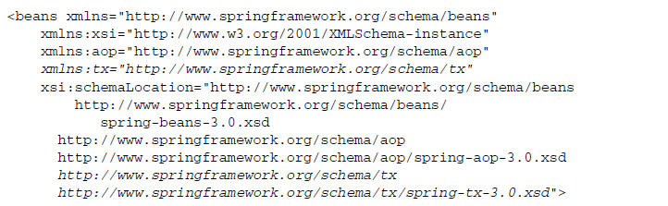
Note that the aop namespace should also be included. This is important, because some of the declarative transaction configuration elements rely on a few of Spring’s AOP configuration elements

Slide 43
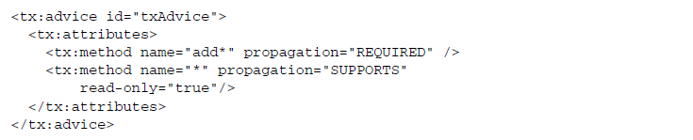
The tx namespace provides a handful of new XML configuration elements, most notably the <tx:advice> element.
With <tx:advice>, the transaction attributes are defined in a <tx:attributes> element, which contains one or more <tx:method> elements. The <tx:method> element defines the transaction attributes for a given method (or methods) as defined by the name attribute (using wildcards).

Slide 44
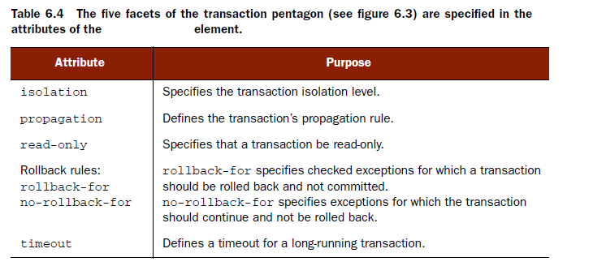
As defined in the txAdvice transaction advice, the transactional methods configured are divided into two categories: those whose names begin with add and everything else.

Slide 45

When declaring a transaction using <tx:advice>, you’ll still need a transaction manager just like you did when using TransactionProxyFactoryBean.
Choosing convention over configuration, <tx:advice> assumes that the transaction manager will be declared as a bean whose id is transactionManager. If you happen to give your transaction manager a different id (txManager, for instance), you’ll need to specify the id of the transaction manager in the transactionmanager attribute:

Slide 46
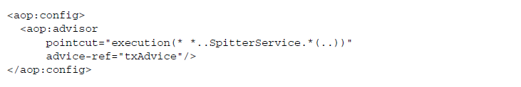
On its own, <tx:advice> only defines an AOP advice for advising methods with transaction boundaries. But this is only transaction advice, not a complete transactional aspect.
To completely define the transaction aspect, we must define an advisor. This is where the aop namespace gets involved.

Slide 47
The transaction advice, which is referenced with the advice-ref attribute to be the advice named txAdvice, defines which methods are actually run within a transaction as well as the transactional attributes for those methods.

Slide 48
Exercise 6-2
Open spitter-service-declarative-tx-exercise
Run SpitterServiceImplTest.java – should add an entry to spitter.spittle table in the database
Do declarative transaction so that spitterService.saveSpittle(spittle) will not be writing to the database after the ArithmeticException is thrown
Add service-context.xml as ContextConfiguration
Add <tx:advice> and <aop:advisor>

Slide 49
6.4.3 Defining annotation-driven transactions
In addition to the <tx:advice> element, the tx namespace provides the <tx:annotation-driven> element.
That single line of XML packs a powerful punch that lets you define transaction rules where they make the most sense: on the methods that are to be transactional.

Slide 50
The <tx:annotation-driven> configuration element tells Spring to examine all beans in the application context and to look for beans that are annotated with @Transactional, either at the class level or at the method level.
For every bean that is @Transactional, <tx:annotation-driven> will automatically advise it with transaction advice.
The transaction attributes of the advice will be defined by parameters of the @Transactional annotation.

Slide 51
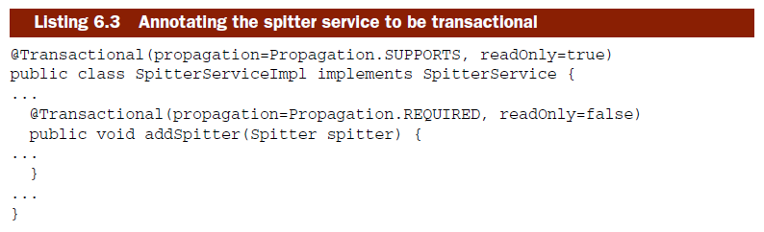
Notes:
At the class level, SpitterServiceImpl has been annotated with an @Transactional annotation that says that all methods will support transaction and be read-only. At the method level, the saveSpittle() method has been annotated to indicate that this method requires a transactional context.

Slide 52
Exercise 6-3
Convert spitter-service-declarative-tx-exercise to annotation-based

Slide 53
-End of Chapter 6-

